Slide 1
EXCRETORY SYSTEM

Slide 2
FUNCTION: nutrition
ORGANS:
LUNGS: expell CO2
SKIN: expells water and salts
LIVER: filters and expell wastes to the blood
URINARY SYSTEM: expells urine.
All the wastes come from the cell’s metabolism.

Slide 3
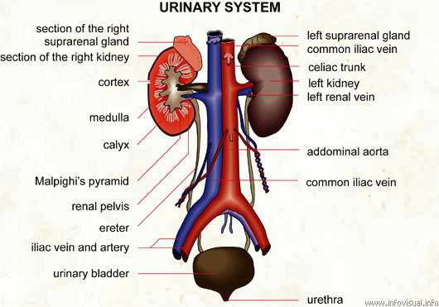
ANATOMY:

Slide 4
THE NEPHRON: the unit of the urinary system.
http://www.youtube.com/watch?v=aQZaNXNroVY
Nephrone: cell composed by some parts:
The glomerulus and Bowman’s capsule
The proximal convoluted tube
Henle’s Loop
The distal convolulted tube
The Collecting duct

Slide 5
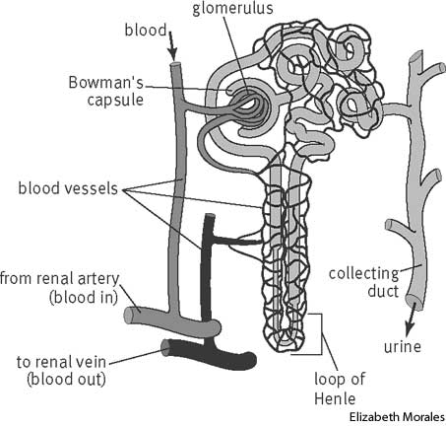

Slide 6
Nephrone’s functions:
The production of urine involves:
Filtration of the blood through the glomerulus.
Reabsorption of the substances needed to mantain the body’s balance.
Secretion of the formed urine.

Slide 7
PRODUCTION OF URINE
Urine: liquid obtained from the blood and made up of water , minerals and waste products (urea and uric acid). It is produced in two phases:
1.- Glomerular filtration: Water and certain solutes pass into Bowman’s capsule (Not proteins).
2.- Tubular reabsorption: As they travel through the nephron’s tubule, a lot of filtered substances are reabsorbed (glucose, vitamins, aminoacids, water, sodium,…) Water is absorbed in the loop of Henle.

