Slide 1
Health and disease

Slide 2
WHO: the world health organization
Who defines health as “complete physical, mental and social well-being, not just the mere abscence of desease.”

Slide 3
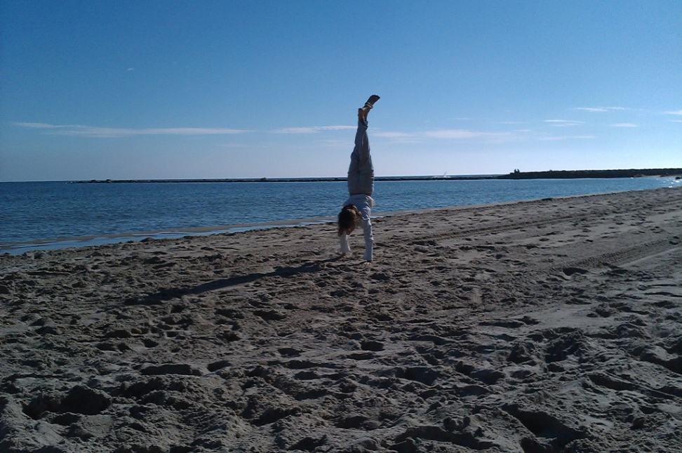
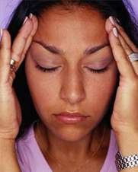

Slide 4
Factors that play a part in preventing deseases and maintaining health
A healthy environment
Healthy habits
Genetic and personal characteristics
Efficient anb high-quality health care systems
Notes:
hea

Slide 5
Symptoms: apparent to the person
Signals: observed by others
Diagnose: to determine the disease
Treatment: medical care or attention (curative or symptomatic)
Convalescence: period to completely recover

Slide 6
Types of deseases
criterion | type | definition | example
By origin | infectious | Pathogenic microorganisms | Rabies Measles STD
 | Non-infectious | Not microorg. | Gout
By appearence and duration | acute | Manifests quickly Lasts short | Flu
 | chronic | Manifests slowly Lasts long | Arthritis
By incidence in the population | sporadic | Very few cases | Strokes
 | endemic | Common and exclusive of a region | Malaria
 | epidemic | Lot of people | Flu
 | pandemic | Spreads all over the world | AIDS

Slide 7
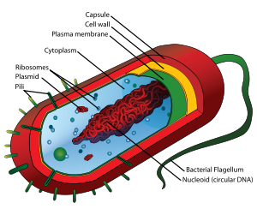
Infectious deseases
Cause: pathogenic microorganisms
that infect healthy people destroying cells by producing toxines or destroying them directly. (Virulence)
BACTERIA: single-celled prokaryotes. Toxines
(Diphteria)
FUNGI: heterotrophic eukaryotic. (Athlete’s foot)
PROTOZOA: single-celled eukaryotes (sleeping sickness)
VIRUSES: non-cellular. Parasites of cells. (Polio)

Slide 8
Sexually transmitted deseases
Type | Organism | Name in Engllish | Spanish name
Bacterial | Haemophilus ducreyi | Chancroid | Chancro
 | Chlamydia trachomates | Clamydia | Clamidia
 | Neisseria gonorroheae | The clap | gonorrea
 | Klebsiella granulomatis | Granuloma inguinalis | granuloma
 | Treponema pallidum | Syphilis | sífilis
Fungal | Candida albicans | Candidiasis | Candidiasis
Protozoal | Trichomonas vaginalis | Trichomoniasis/ trich | Tricomoniasis

Slide 9
Sexually transmitted deseases
Type | Organism | Name in Engllish | Spanish name
Virial | Hepatitis B virus | Virial hepatitis | Hepatitis B
 | Herpes simplex virus 1,2 | Herpes simplex | Herpes genital
 | Human Inmunodeficeincy virus | HIV | SIDA
 | Human Papillomavirus | HPV | Papiloma
Parasites | Pthirius pubis | Crab louse or pubic lice | Ladilla
 | Sarcoptes scabies | Scabies | sarna

Slide 10
Prevention of STD
CONDOMS. That’s the only way!
Condoms prevent gestation and STD.
Is it clear????

Slide 11
Transmission of infections
Direct contact
By touching inert objects
By drinking contaminated water
By eating contaminated food
By breathing contaminated air
Through contact with VECTORS: can transmit pathogenic microorganisms without getting the desease (insects or other animals)

Slide 12
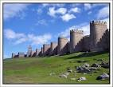
Body’s defences
External defences: Structural, biochemical, mechanical, ecological
Internal defences:
Non specific: phagocytes
Specific: antibodies (lymphocytes)

Slide 13
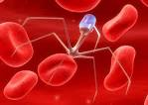
Defences
External:
Skin, mucosae, saliva, juices, cilia, non-pathogenic organisms.
Internal: White blood cells.
Non-specific defences:
Protect against any type of pathogenic microorganisms: Phagocytes
Specific defences: against specific foreign molecules called antigens. Lymphocytes produce antibodies specific to one antigen.

Slide 14
Local responses: A wound
Inflammatory response: Capillaries dilate, bloodstream increases, phagocytes come. Inflammation and blushing.
Local temperature raises to help phagocytes to move.
Pus is composed by rests of white blood cells and germs.

Slide 15
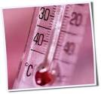
Fever and inflammation
Both work with the body in its fight against the invading microorganisms.
Fever helps the white blood cells act more effectively and makes it more difficult for the pathogens to reproduce.
Inflammation permits greater blood flow. This allows white cells and antibodies to arrive at the site of infection.

Slide 16
General responses:Immune response
Third defence line: Lymphocytes.
Lymphocytes produce specific proteins called antibodies.
Antibodies are specific against antigens.

Slide 17
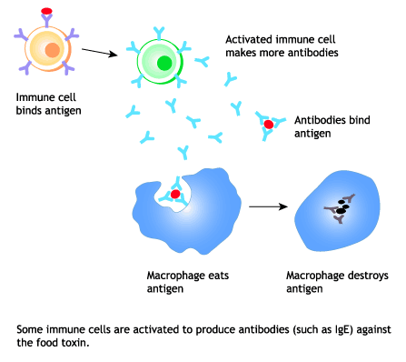
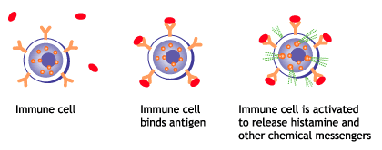
Antigen-antibody reaction

Slide 18
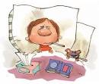
Infection deseases’ developing
1.- Incubation period
2.- Illness period
3.- Convalescence period
4.- Recovery

Slide 19
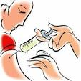
Habits to prevent infectious deseases
Hygiene,
antiseptics, desinfectants,
keep your immune system healthy: sleep, diet, exercise, no drugs;
medicines just with prescription.
Vaccination: a dead, weakened or inactive pathogenic microbe being injected into the body of a healthy person to produce antibodies against the antigens of the microbe.

Slide 20
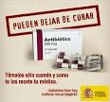
Curing infectious deseases
Serum therapy: a liquid that contains antibodies is given to a infected person (serum). Antibodies are produced by another person or an animal.
Drug therapy: adminitering medication. Microbicides destroy microbes. Microbiostatic prevent microbes from reproducing. Antibiotics and sulphonamides are the most important.
USE ANTIBIOTICS CAREFULLY!!!!

Slide 21
Non-infectious deseases
Deseases related to specific systems: cardiovascular
Cancer: tumour
Related to malnutrition: scurvy
Traumatic injuries: accidents
Endocrine and metabollic: excessive or deficient secretion of a hormone: obesity, diabetes
Mental and behavioural disorders
Genetic deseases

Slide 22
Health care
Primary care doctor
Medical specialist
Hospitalisation
Trasplants: is the transfer of an organ, tissue or group of cells from one individual to antother to replace an organ that no longer works.
Organ and tissue transplants: transfusion
Cell transplants: stem cells (embryonic or adult cells)
Problems: Preserving the organ, surgical complications and rejection

