Slide 1
NUTRITION
Digestive System
Respiratory System
Circulatory System
Lymphatic System
Aparato excretor

Slide 2
NUTRICIÓN
Types
Processes
System
Autotrophic
Heterotrophic
Ingestion (intake)
Digestive
Transformation
Respiratory
Distribution
Circulatory
Elimination
Excretory

Slide 3
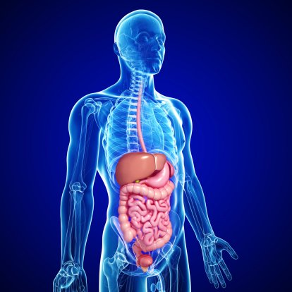
DIGESTIVE SYSTEM
PROCESSES
INGESTION (INTAKE)
TRANSFORMATION (DIGESTION)
ABSORPTION
ORGANS
MOUTH
PHARINX
ESOPHAGUS
STOMACH
SMALL INTESTINE
LARGE INTESTINE
APPENDIX
RECTUM
ANUS
GLANDS:
SALIVARY GLANDS
LIVER
GALL BLADDER
PANCREAS

Slide 4
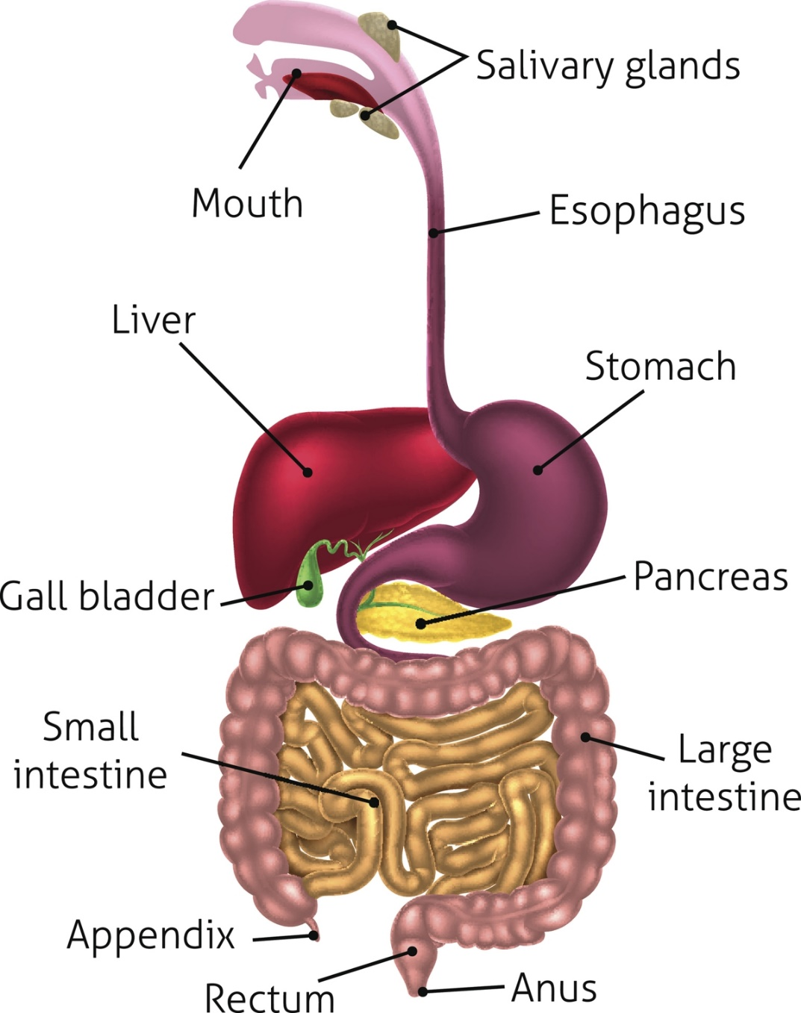
DIGESTIVE SYSTEM

Slide 5
DIGESTIVE SYSTEM
PROCESSES
INGESTION (INTAKE) | MOUTH
TRANSFORMATION (DIGESTION) | MOUTH STOMACH DUODENUM (first part of the small intestine)
ABSORPTION | LARGE AND SMALL INTESTINE

Slide 6
DIGESTION
FOOD CAN BE DIGESTED BY COMBINATION OF TWO METHODS:
Mechanical: In mechanical digestion, food is physically broken down into smaller fragments via the acts of chewing (mouth), churning (stomach) and segmentation (small intestine).
Chemical digestion: food is broken down by the action of chemical agents (such as enzymes, acids and bile)

Slide 7
MECHANICAL DIGESTION
Chewing (Mouth)
Food is initially broken down in the mouth by the grinding action of teeth (chewing or mastication)
The tongue pushes the food towards the back of the throat, where it travels down the esophagus as a bolus
The epiglottis prevents the bolus from entering the trachea, while the uvula prevents the bolus from entering the nasal cavity
Churning (Stomach)
The stomach lining contains muscles which physically squeeze and mix the food with strong digestive juices ('churning’)
Food is digested within the stomach for several hours and is turned into a creamy paste called chyme
Eventually the chyme enters the small intestine (duodenum) where absorption will occur

Slide 8
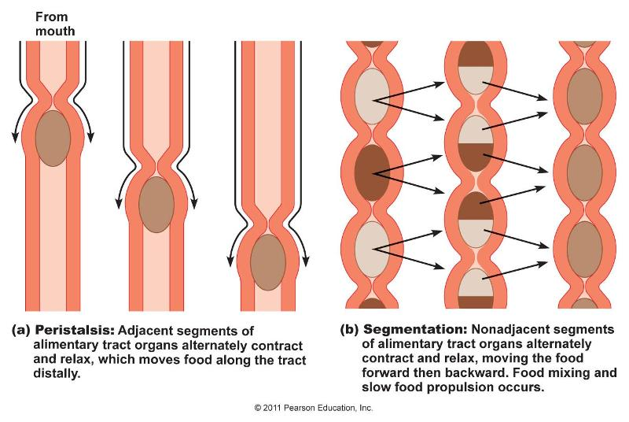
MECHANICAL DIGESTION
Segmentation and peristalsis (Intestine)
Segmentation involves contractions of the circular muscles in the digestive tract.
Peristalsis involves rhythmic contractions of the longitudinal muscles in the gastrointestinal tract. Unlike peristalsis, segmentation actually can slow progression of chyme through the system.

Slide 9
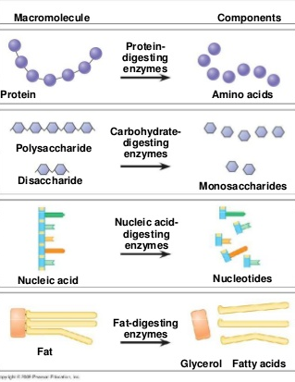
CHEMICAL DIGESTION

Slide 10
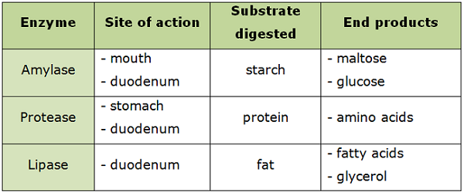
CHEMICAL DIGESTION

Slide 11
1st Stage: The Mouth
Chemical digestion: Saliva breaks down the poisaccharids into more simple molecules.
Mechanic digestion: teeth and molars crush the food.

Slide 12
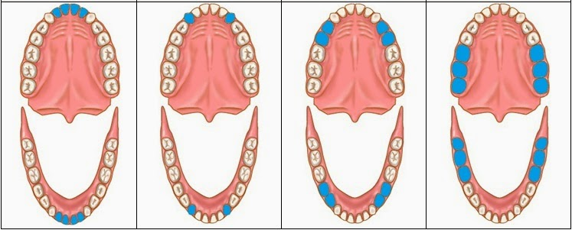
Mechanical Digestion
INCISORS
(Cut)
CANINES
(Tear)
PREMOLARS
MOLAR
(Crush and Crumble)

Slide 13
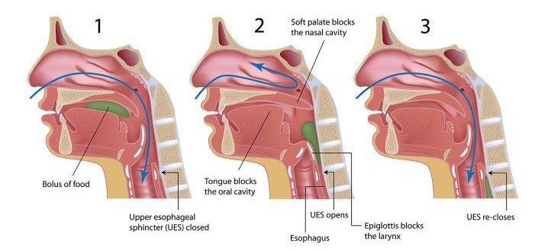
Swallowing

Slide 14
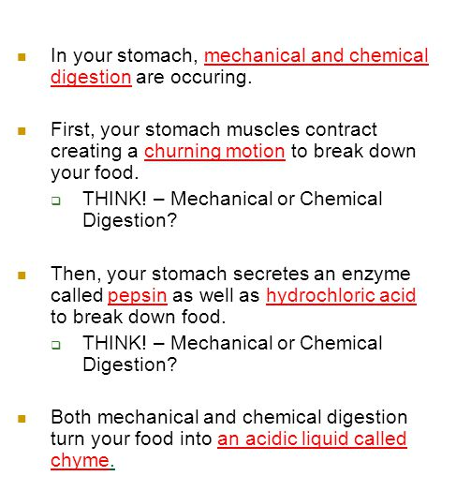
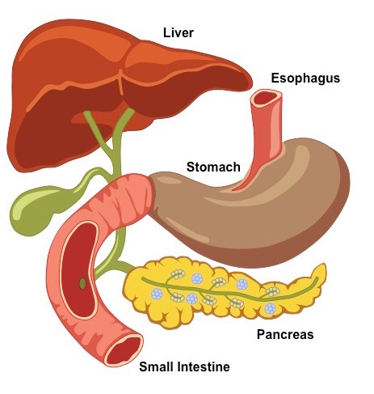
2nd Stage: STOMACH

Slide 15
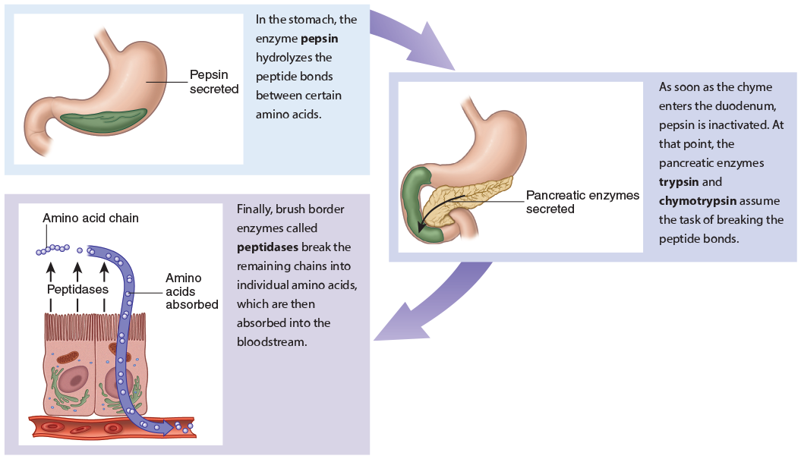
2nd Stage: STOMACH

Slide 16
3rd Stage: INTESTINE
DUODENUM

Slide 17
3rd Stage: INTESTINE

Slide 18
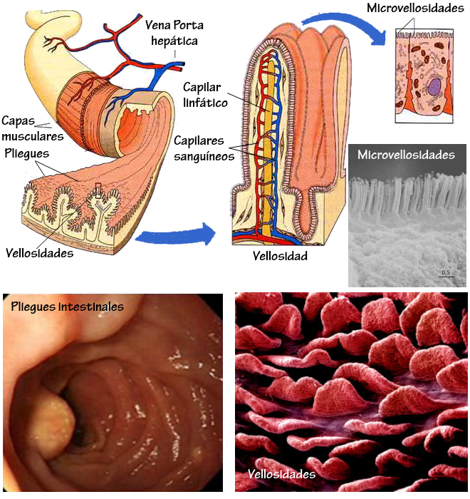
3rd Stage: INTESTINE
Absortion

Slide 19
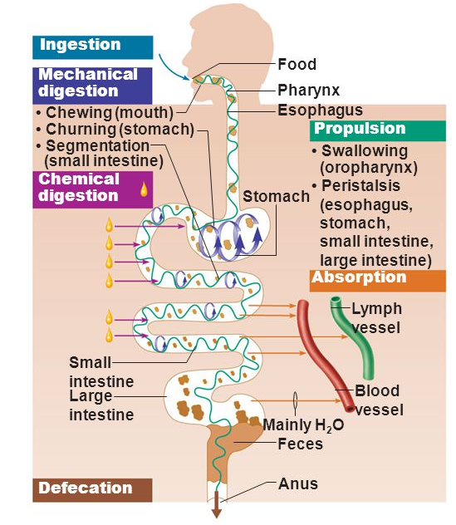

Slide 20
