Slide 1
Nervous system and endocrine system
INTERACTION FUNCTION

Slide 2
The nervous system
Interaction consists of a series of functions which help the body to:
Adapt to change
Coordinate different parts of the body to work as one unit

Slide 3
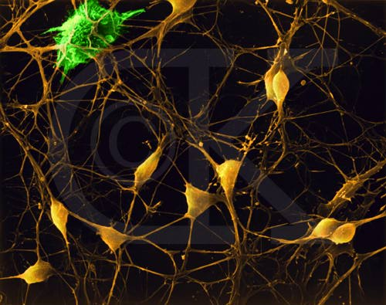
Nerve cells

Slide 4
Senses+nervous s+endocrine s
work together :
stimuli
sensory organs
nervous system
effectors endocrine system
locomotor system

Slide 5
Functions of the nervous system
It processes information
It interprets information recieved from the sensory organs
It works out appropiate responses to this information
It sends instructions to the effectors
It coordinatesthe functions of the body’s organs
It carries out intellectual and mental processes
It transmits emotions and feelings

Slide 6
Neurons
Neurons communicate with each other in a complex network. They carry information through electrical signals called nerve impulses.
Types of neurons: sensory, motor, interneurons.
Characteristics:
Cell body
Axon: it ends in axon terminals (covered with myelin)
Dendrites: one of the many short projections from the cell body
Neurons can not divide. They are not replaced.

Slide 7
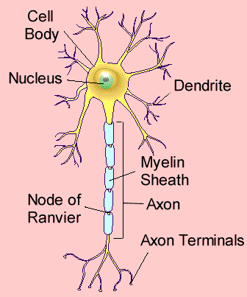
Parts of a neuron

Slide 8
The nerve impulse
Neurons are not isolated; they work together in groups. There is a small gap between the axon terminals of one neurone and the dendrites of another one. The gap is called synapse.
Inside each axon terminal are very small vesicles containing chemicals called neurotransmitters. Depending on the neurotransmitter, the second neurone either continues the nerve impuse or stops it.

Slide 9
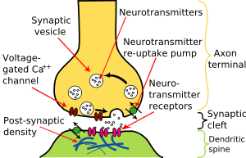
synapse

Slide 10
The central nervous system
Components:
The spinal cord
The brain
Tissues:
Grey matter: mainly cell bodies and dendrites
White matter: mainly nerves (coverd in myelin)
Protected by the skull and the spine. The brain is surrounded by membranes called meninges. Between the tissue is a fluid called cerebrospinal fluid.

Slide 11
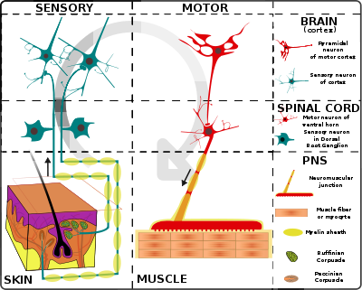
The nerve pathway

Slide 12
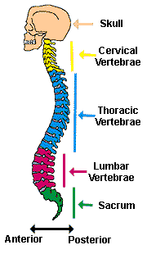
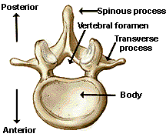
The spinal cord and the vertebra

Slide 13
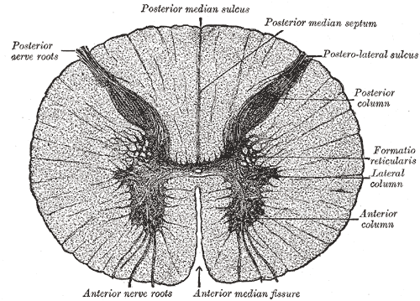
The spinal cord
It is a cylinder of nerve tissue that runs through the spine.
Functions:
It produces reflexes: actions that happen automatically in response to a stimulus.
It carries nerve impilses.

Slide 14
The brain
Sections:
1.-The brain stem: connected to the spinal cord. It controls vital functions like heartbeats.
The nerves cross over in it.
2.-The cerebellum: at the back of the brain. It processes information from the ear related to balance. Coordination of movements.
3.-The cerebrum: The outside is grey matter called cerebral cortex. It is responsible for all thought, voluntary movement and learnt behavour. It is divided into 2 hemispheres (left and right)

Slide 15
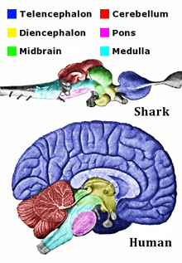
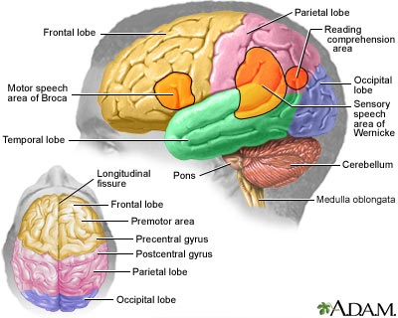
The brain in evolutionary time

Slide 16
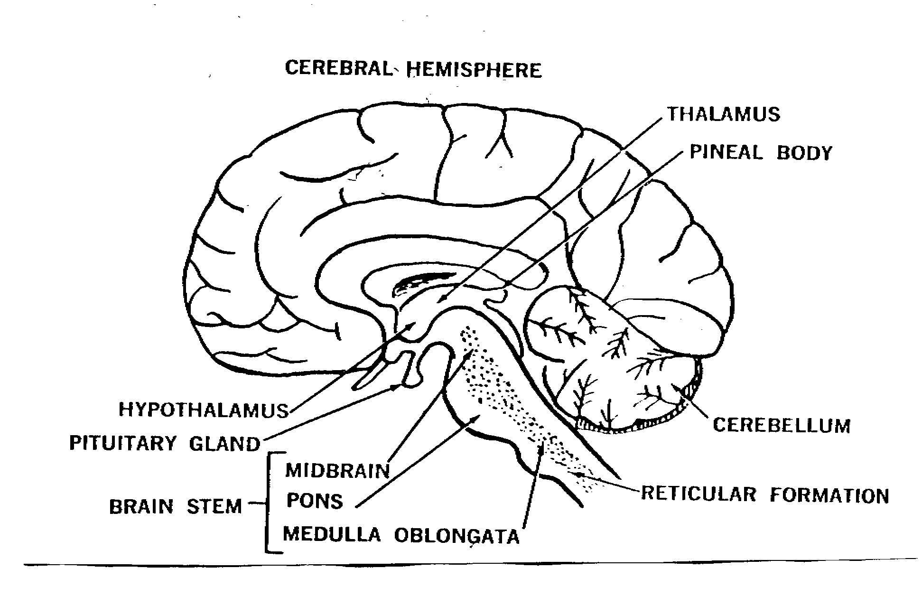
The brain

Slide 17
The peripheral nervous system
A nerve is a cable filled with myelin-covered axons and other tissues. It carries nerve impulses.
Components:
Sensory receptors
Sensory nerves
Motor nerves
Sections:
The somatic or voluntary nervous system
The autonomic or involuntary nervous system

Slide 18
The somatic system
Nerves for the external sensory organs and for voluntary muscle movement.
Cranial nerves: 12 pairs of nerves that enter and leave the brain. They communicate with the sensory organs in the head and internal organs.
Spinal nerves: 31 pairs of mixed nerves. They contain sensory (dorsal root of the spine) and motor neurons (ventral root).

Slide 19
The autonomic system
It is responsible for regulating and controlling involuntary body functions.
Parts:
Sympathetic: It prepares the organism to work more effectivily under stress.
Parasympathetic: it mantains the organism when the body is at rest or is working slowly.

Slide 20
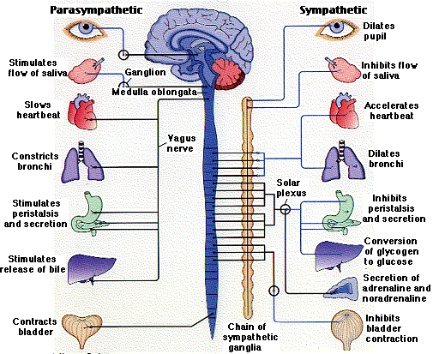
The autonomic nervous system

Slide 21
Nerve actions
Reflexes: quick and automatic actions that happen when a rapid response is required. Reflexes do not involve the brain, they only involve the spinal cord.
Voluntary actions: slower and more elaborated actions. The cerebral cortex has a key role involuntary actions.

Slide 22
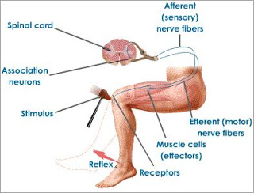
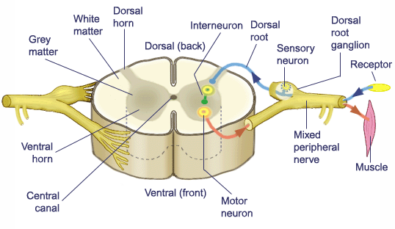
Involuntary and voluntary actions

Slide 23
The Endocrine System
The endocrine system is a group of endocrine glands that release hormones directly into the bloodstream.
Hormones activate cells to start, stop, increase or decrease specific functions.
Each hormone acts only on specific cells called target cells.
The endocrine system depends on commands from the brain. The most important gland is the Pituitary gland which is connected to and controlled by the hypothalamus in the brain.

Slide 24
Hormone Production
Hypothalamus neurones stop production
nerve signals
Pituitary gland
stimulating hormones (SH)
Endocrine glands
specific hormone (H) excess
Action
Feedback

Slide 25
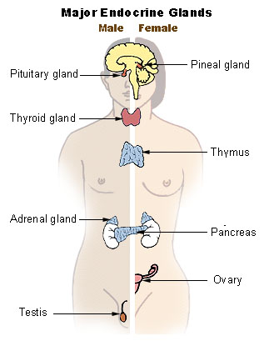

Slide 26
Human glands and hormones
Gland | Hormones | Action
Pituitary gland | Vasopressin Oxytocin Stimulatin H Growth H | Restricts water in kidneys Contracts uterus Activate glands Lengthening bones
Thyroid gland | Thyroxine | Stimulates metabolism
Parathyroid gland | Parathyroid H | Levels of Ca and P
Pancreas | Insuline Glucagon | Controls glucose Stimulates conversion of glycogen to glucose in the liver
Adrenal glands | Adrenaline Corticosteroids | Prepares for work Metabolism of elements
Ovaries | Oestrogenus Progesterone | Female sexual characteristics Prepares the uterus to mantain an embryo
Testicles | Androgens | Male sexual characts.

