Slide 1
RECEPTORS AND EFFECTORS
SENSES, MUSCLES AND BONES

Slide 2
SENSORY RECEPTORS
receptor | stimuli | sense
Photoreceptors | light | Eyes
Mechanoreceptors | Changes in movement, pressure, waves, sound, contact, pain | Ears Skin Muscles
Chemoreceptores | Chemical changes | Taste Smell
Thermoreceptors | Changes in temperature | skin

Slide 3
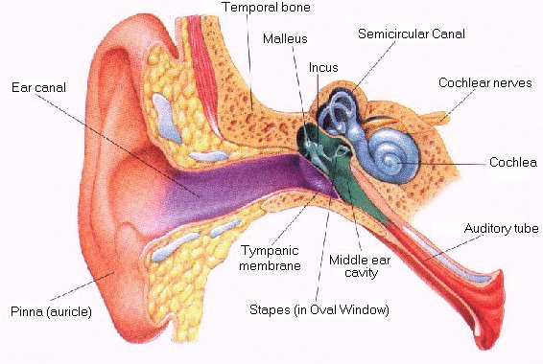
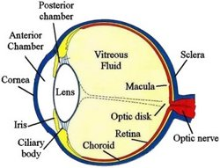
Eyes and Ears
EYE Anatomy
Ear anatomy

Slide 4
Sight
Regulation of the intensity of light: pupil.
It does this through the contraction or relaxation of muscles located in the iris.
Focusing the images in the retina: lens.
It does this through the muscles of the ciliary body.
Flat: destant objects
Curved: near

Slide 5
Sensory cells
Sensory cells are located in the retina. This layer is composed of different neurons adapted to recieve different intensity of light or different colors. (Rodes and cones)
The neurons will form a nerve, the optic nerve, to send the information to the brain.

Slide 6
Hearing and balance
Vibrations reach the eardrum. Then it is transmitted through the bones of the middle ear. This action causes the fluid in the inner ear to vibrate stimulating the cells of the cochlea, which make up the organ of Corti. This organ is made up of neurons that form a nerve, the auditory nerve.
The vestibule contains perilimph that runs inside the three channels (semicircular channels) and two vesicles (utricule and sacule). Limph movements determine the position along with vision and other mechanoreceptors.

Slide 7
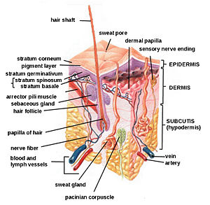
Touch

Slide 8
Skin receptors
receoptor | Stimuli
Nerve endings (surface) | Pain
Krause corpuscle | Cold
Ruffini corpuscle | Heat
Meissner corpuscle | Touch
Pacinian corpuscle | pressure

Slide 9
Taste and smell
Taste
Smell
Stimuli: chemical substances in food
Receptors: taste buds
Place: mouth
Stimuli: chemical substances in air
Receptors: olfactory cells in olfactory bulbs
Place: nasal cavities
3000 different smells

Slide 10
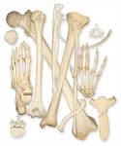
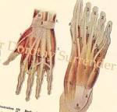
Locomotion
Passive parts: bones
Active parts: muscles
Bones give the body structure and support.
Muscles are attached to bones, and move
them.

Slide 11
Bones
Bones are formed by the ossification of cartilage. Calcium is needed for stronge bone growth.
Functions:
Support
Shape
Protection
Attachments for muscles
Produce red blood cells

Slide 12
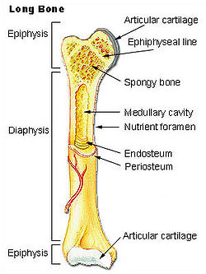
Long bones

Slide 13
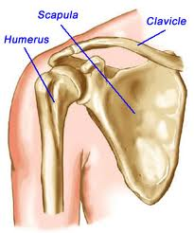
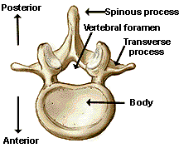
Bones: short and flat bones

Slide 14
Joints
There are three kinds of joint: fixed, movable, and semi-movable.
Fixed joints stop the bones from moving. Skul.
Movable joints allow us to move. They contain a lubricating liquid, called synovial fluid. They also have ligaments, which keep the bones united. Elbow.
Semi-movable allow only limited movements. Vertebrae.

Slide 15
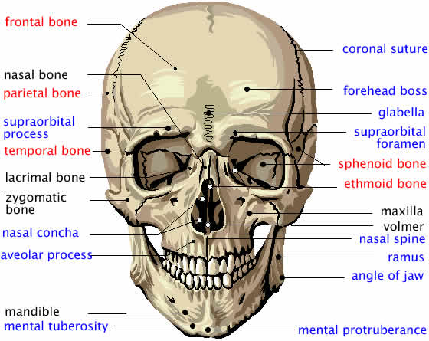
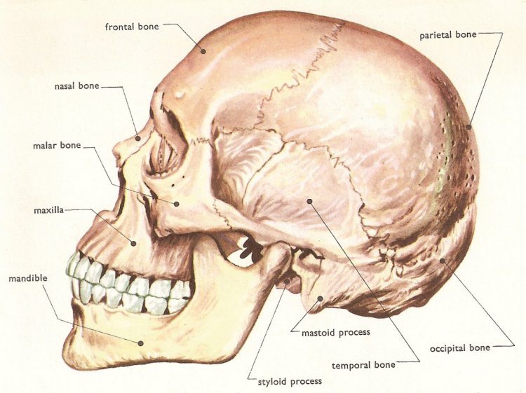
Skull

Slide 16
Muscles
Muscles are made up of muscle-fibre bundles. Each bundle contains many long elongated muscle fibres.
When they join up the protective coverings form a special kind of tissue called tendons, which connect a muscle to a bone.
Muscles contract by becoming shorter. The energy is obtained from cellular respiration.
To produce the desired movement, various muscles must be coordinated at the same time. They are called agonist, they work agains other muscles called antagonists: one contracts and the other relaxes.

Slide 17
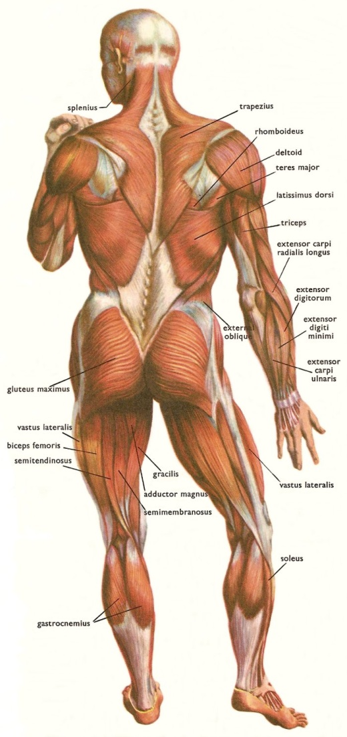
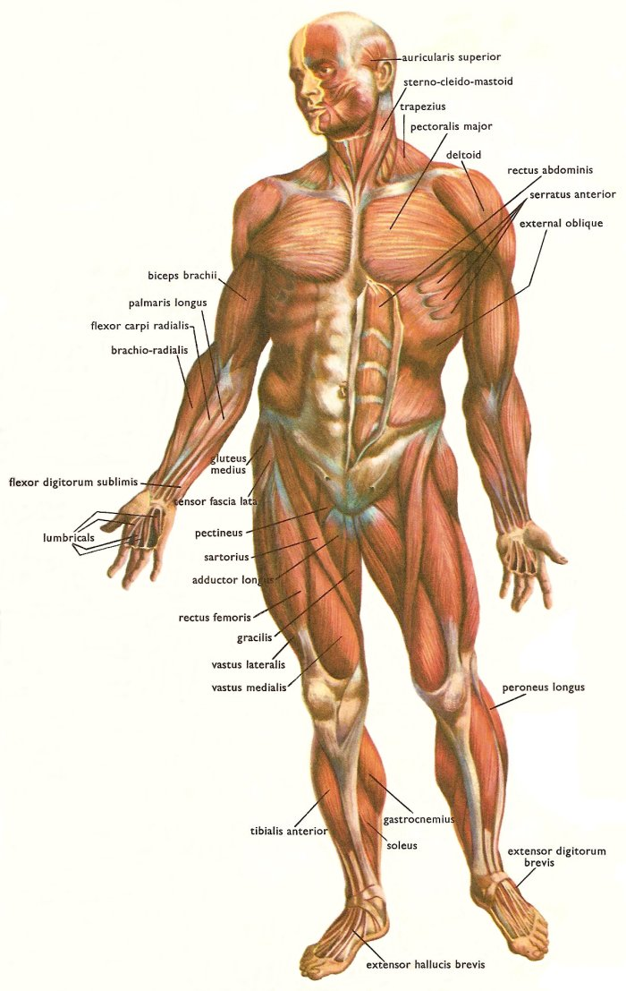
Human muscles

